Slide 1
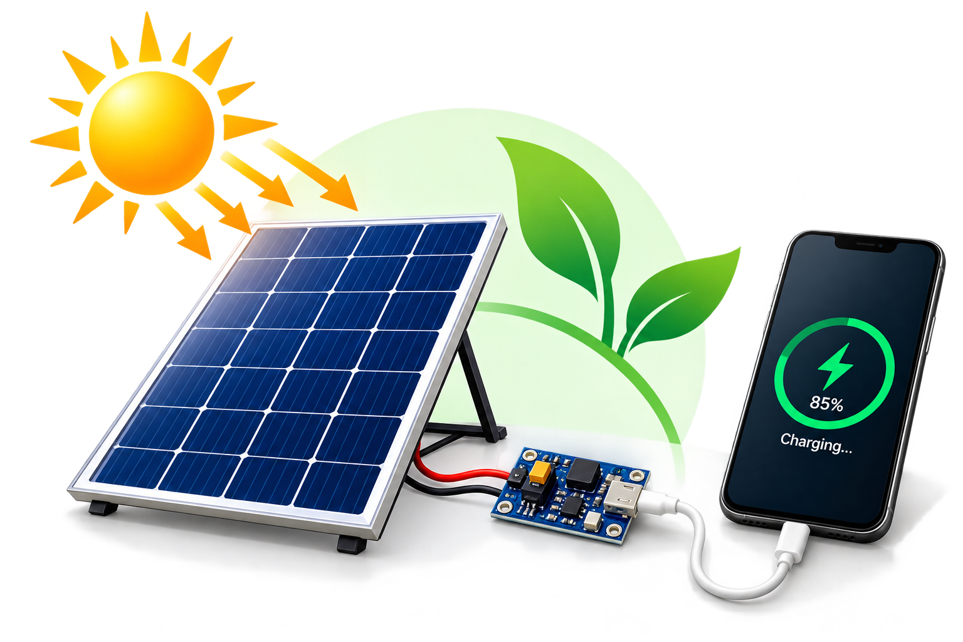
MOBILE PHONE CHARGER USING SOLAR PANEL
Presented by:
MANOJ R M
THAARUN AAKASH I
NAVEEN PS
Under the Guidance of:
Mr. K. ANBUTHIRUVARANGAN
Department of Computer Science and Engineering
Sri Manakula Vinayagar Engineering College
Madagadipet, Puducherry
Academic Year: 2026–2027

Slide 2
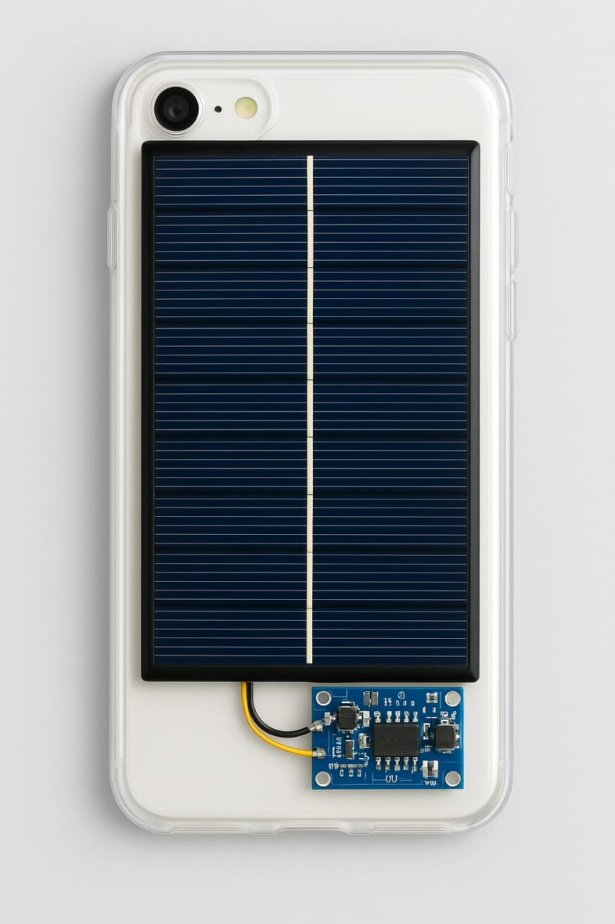
Objective
To design and build a portable solar-powered mobile charger that uses a 5V, 1A solar panel and a TP4056-based regulator module and provide USB charging for mobile phones during daytime.

Slide 3
Components
Solar panel
Regulator/charger module
USB output / connector.
Wires, connectors & enclosure — for mechanical support and safety.

Slide 4
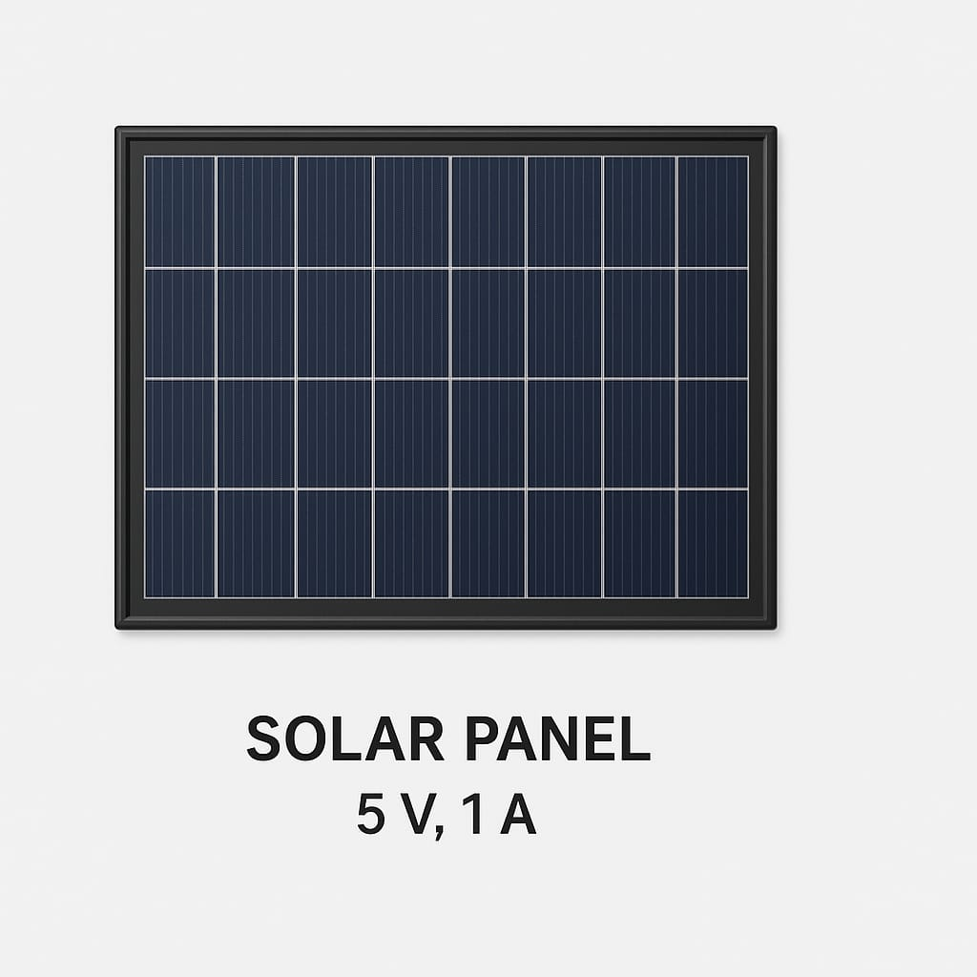
Component Explanations
Solar panel: Converts sunlight into DC. Your panel is rated ~5V / 1A — suitable for small charging tasks.
TP4056-based module: A CC/CV linear charger for batteries. Provides safe charging and usually includes ICs (DW01 + FS8205A).
USB output: Standard interface to connect the phone. To guarantee stable 5V output, a boost (step-up) converter may be needed if using voltage.
Enclosure & wiring: Keeps parts secure; use correct polarity and fuses for safety.

Slide 5
SOLAR PANEL
Solar Panel (PV Module)
Identified component: Solar panel used in the Solar Powered Mobile Phone Charger project.
Function: Converts sunlight into DC electrical energy through the photovoltaic effect.
Output: Generates DC voltage when exposed to sunlight.
Role: Supplies the electrical energy required by the voltage regulation/DC-DC conversion module for mobile phone charging.
Performance: Output depends on sunlight intensity, panel orientation, and the panel's rated specifications.

Slide 6
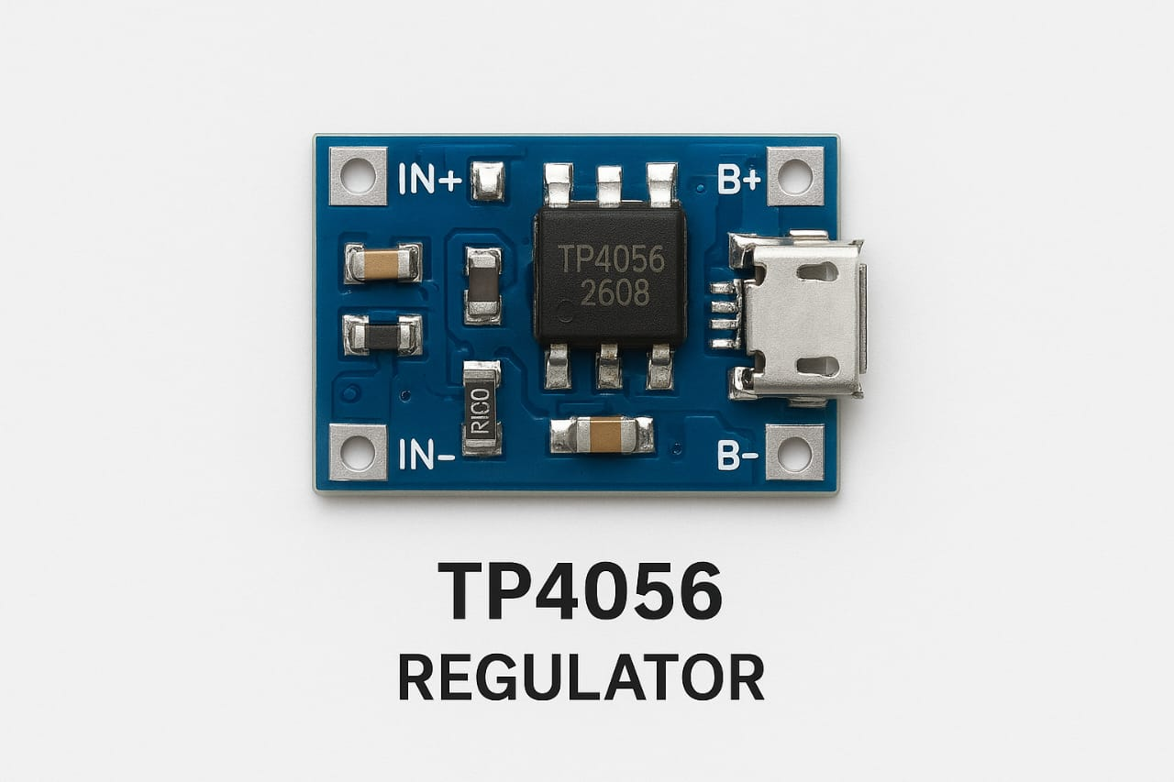
REGULATOR (MODULE) DETAILS
Identified regulator: From the photo the small blue board shows markings like B+/B- and OUT+/OUT- — this is a TP4056-based Li‑ion charging module (common inexpensive charger).
Features: Constant-Current / Constant-Voltage (CC/CV) charging
Role: Takes the 5V input from the solar panel and safely charges the while protecting against overcharge/discharge.

Slide 7
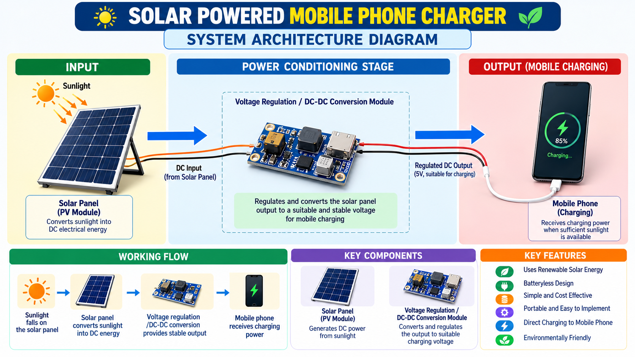
ARCHITECTURE DIAGRAM

Slide 8
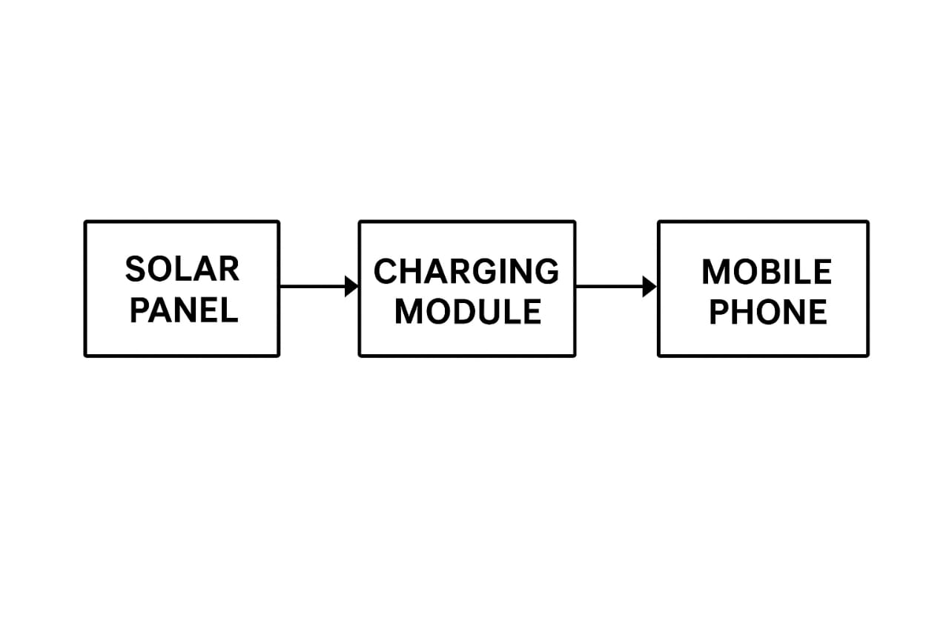
Working Principle:
1) Sunlight → Solar panel (5V/1A) produces DC power.
2) Solar output → TP4056 charger/regulator (controls current/voltage)
3) / panel → USB output (with optional boost converter) → Mobile phone (5V USB).
Note: TP4056 is a charger, not a boost converter. For stable 5V USB output from a , add a step-up (boost) module.

Slide 9
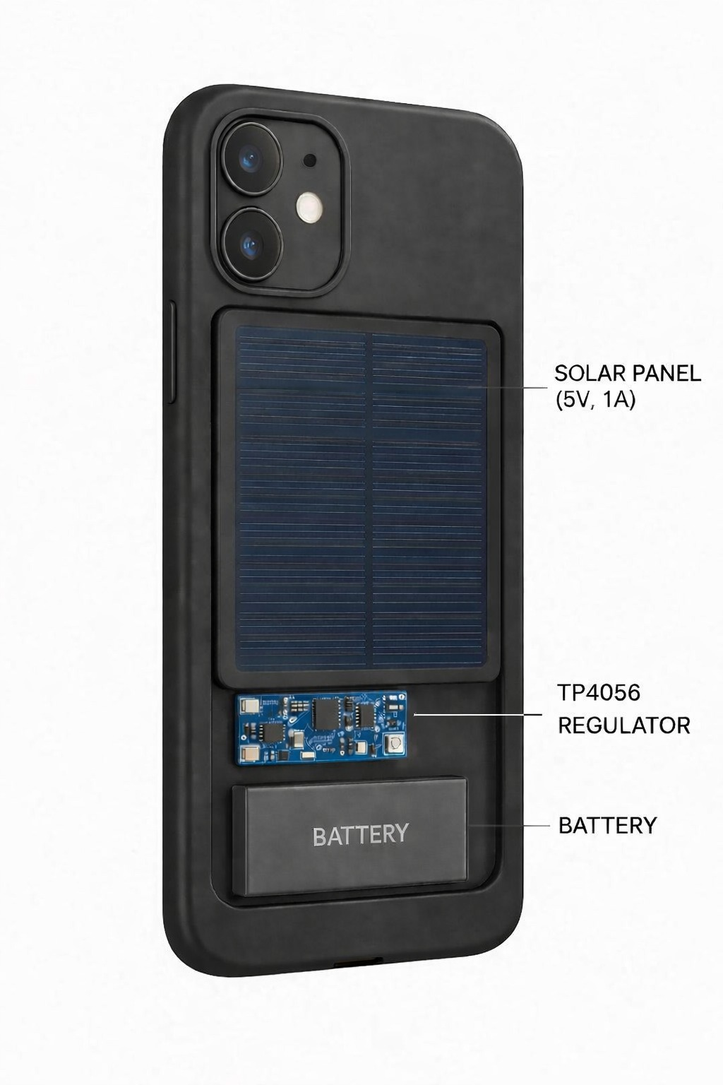
FUTURE ENHANCEMENT
The Solar Powered Mobile Phone Charger can be enhanced in the future to improve its efficiency, reliability, and practical usability. The following enhancements can be considered:
Battery Storage: A rechargeable battery can be incorporated to store excess solar energy for charging when sunlight is unavailable.
Improved Power Regulation: An efficient voltage regulation circuit can be used to provide a more stable output.
Higher-Efficiency Solar Panel: A more efficient solar panel can improve energy generation.
Charging Protection: Suitable protection circuits can be added to protect the system against overvoltage and excessive current.
Portable Design: The system can be developed into a compact and lightweight charging device.
Performance Monitoring: Voltage and current monitoring can be introduced to observe the system's performance.

Slide 10
Advantages & Limitations
Advantages: Renewable, portable, low maintenance, useful in remote areas and emergencies.
Limitations: Charging depends on sunlight; cloudy days reduce performance. TP4056 doesn't provide 5V boost by itself.
Suggestion: For reliable phone charging, include a + a 5V boost converter.

Slide 11

Conclusion
Conclusion:
  A compact and practical project demonstrating solar energy for everyday charging. Safe charging requires proper management and a stable 5V output for phones.

